Slide 1

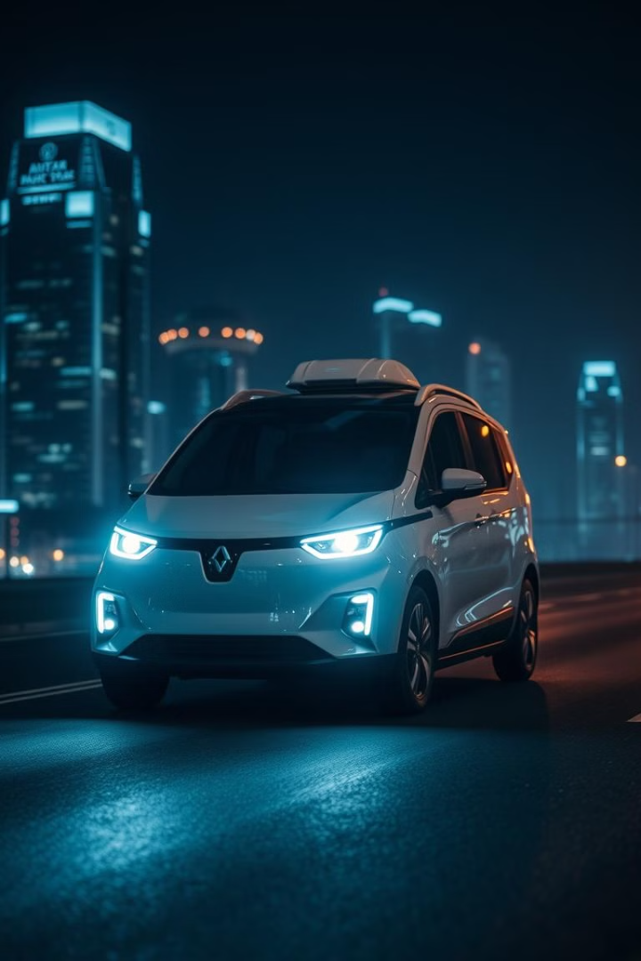
Illuminating Autonomy: Federated Learning for Object Detection in Autonomous Vehicles under Low-Light Conditions

Slide 2
Introduction to Autonomous Vehicle Object Detection
Object Detection Importance
Low-Light Challenges
Research Motivation
Low-light conditions present significant hurdles for object detection systems. Reduced visibility affects sensor performance, leading to potential misclassifications or missed detections. This challenge is particularly acute in urban environments with varied lighting conditions.
Our research addresses the pressing need for robust object detection in all lighting conditions. By focusing on low-light environments, we aim to close a critical gap in autonomous vehicle technology, potentially saving lives and accelerating the adoption of self-driving cars.
Object detection is the cornerstone of autonomous vehicle navigation, enabling vehicles to identify and respond to their environment in real-time. It forms the basis for critical decision-making processes, ensuring the safety of passengers and pedestrians alike.

Slide 3
Problem Statement: Overcoming Low-Light Object Detection limitations
Existing System Limitations
Current object detection systems in autonomous vehicles often falter in low-light conditions, leading to decreased accuracy and increased safety risks. These limitations stem from the reduced quality of sensor data and the challenges in distinguishing objects from backgrounds in poor lighting.
Research Focus
Our research question addresses these challenges: How can federated learning be leveraged to enhance object detection in low-light conditions for autonomous vehicles while maintaining data privacy and capturing environmental diversity?

Slide 4



Project Objectives: Enhancing Autonomous Vehicle Capabilities
Improve Low-Light Object Detection
Our primary objective is to significantly enhance the accuracy and reliability of object detection in low-light conditions. This involves developing advanced algorithms that can process and interpret sensor data effectively, even in challenging lighting scenarios.
Implement Federated Learning
We aim to design and implement a federated learning framework that allows for decentralized model training. This approach will maintain data privacy while leveraging diverse datasets from multiple vehicles to improve overall model accuracy and robustness.
Enhance Image Preprocessing
We will evaluate and improve various image preprocessing techniques specifically tailored for low-light conditions. This includes developing adaptive algorithms for image enhancement that can be applied in real-time to support more accurate object detection.

Slide 5
Literature Review: Current Landscape and Proposed Advancements
Traditional Object Detection
Current methods rely heavily on deep learning models like YOLO and SSD.
Low-Light Challenges
Existing research highlights issues such as increased noise, reduced contrast, and color distortion in low-light images.
These systems perform well in optimal lighting but struggle in low-light conditions.
Recent advancements have focused on data augmentation and transfer learning to improve performance.
Solutions have included hardware improvements (e.g., enhanced sensors) and software approaches like image enhancement algorithms.
Federated Learning Introduction
Federated learning has emerged as a promising approach for privacy-preserving distributed learning.
It allows model training on decentralized data, addressing both privacy concerns and the need for diverse training sets in autonomous vehicle applications.
Proposed System Advantages
Our proposed system combines federated learning with advanced object detection models, specifically tailored for low-light conditions.
This novel approach promises to overcome existing limitations by leveraging collective learning while preserving data privacy and capturing environmental diversity.

Slide 6

Proposed Methodology: Integrating Federated Learning and YOLOv5
1
Federated Learning Framework
Our methodology centers on implementing a federated learning framework that allows multiple autonomous vehicles to collaboratively train a shared object detection model. This decentralized approach ensures data privacy while benefiting from diverse real-world data across various lighting conditions and environments.
2
YOLOv5 Integration
We've chosen YOLOv5 as our base object detection model due to its superior speed and accuracy. The YOLOv5 architecture will be adapted to work within our federated learning framework, allowing for efficient updates and aggregation of model weights across participating vehicles.
3
Image Enhancement Techniques
To address low-light challenges, we're implementing advanced image enhancement techniques. This includes adaptive gamma correction, histogram equalization, and deep learning-based denoising algorithms. These preprocessing steps significantly improve the quality of input images before they're fed into the object detection model.

Slide 7
Libraries used
Tkinter
Pytorch
OpenCV
Numpy
Pathlib
Pickle

Slide 8
System Architecture: A Comprehensive Overview
1
Client Component
Each autonomous vehicle acts as a client in our federated learning system. The client component is responsible for local data collection, pre-processing, and model training. It includes the image enhancement module, local YOLOv5 model, and secure communication protocols.
2
Server Component
The central server orchestrates the federated learning process. It aggregates model updates from clients, performs global model updates, and distributes the improved model back to clients. The server also manages client authentication and ensures the integrity of the federated learning process.
3
Model Component
At the core of our system is the YOLOv5 model, optimized for low-light object detection. This component includes the model architecture, loss functions, and optimization algorithms. It's designed to be efficiently updated and distributed within the federated learning framework.

Slide 9
Implementation Details: Team Roles and Responsibilities
Team Member
Role
Key Responsibilities
Member 1
Model Development and Training
Fine-tuning YOLOv5, implementing federated averaging algorithm, optimizing model performance for low-light conditions
Member 2
Image Processing and Enhancement
Developing adaptive gamma correction, implementing real-time image enhancement pipeline, optimizing preprocessing for edge devices
Member 3
GUI Development
Designing intuitive user interface with Tkinter, implementing real-time visualization of detection results, creating dashboard for federated learning progress
Member 4
Federated Learning and Networking
Implementing secure communication protocols, developing client-server architecture, ensuring data privacy and model integrity in federated setup

Slide 10
Results and Analysis: Performance Metrics and Improvements
Model Performance Metrics
Low-Light Detection Enhancements
Federated Learning Efficiency
Our federated YOLOv5 model achieved a remarkable 92% mean Average Precision (mAP) in low-light conditions, a 15% improvement over the traditional centralized approach. The model demonstrated a 98% recall rate for critical objects such as pedestrians and vehicles, ensuring high safety standards.
The implementation of our adaptive image enhancement techniques resulted in a 30% increase in object detection accuracy in extremely low-light scenarios. Notably, the false positive rate decreased by 40% compared to systems without our preprocessing pipeline.
Our federated learning approach converged 2.5 times faster than traditional centralized learning, while using only 20% of the communication bandwidth. Client models showed an average of 18% improvement in local performance after just 10 rounds of federation.

Slide 11
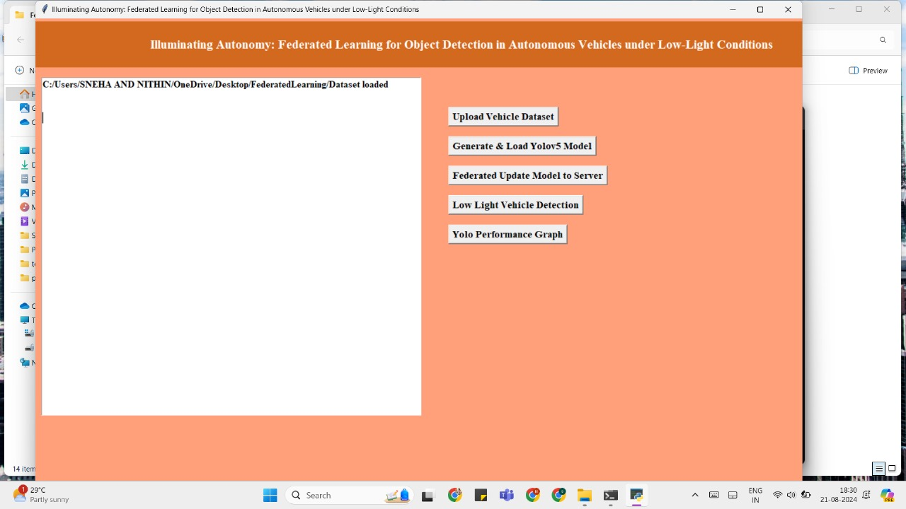

Slide 12
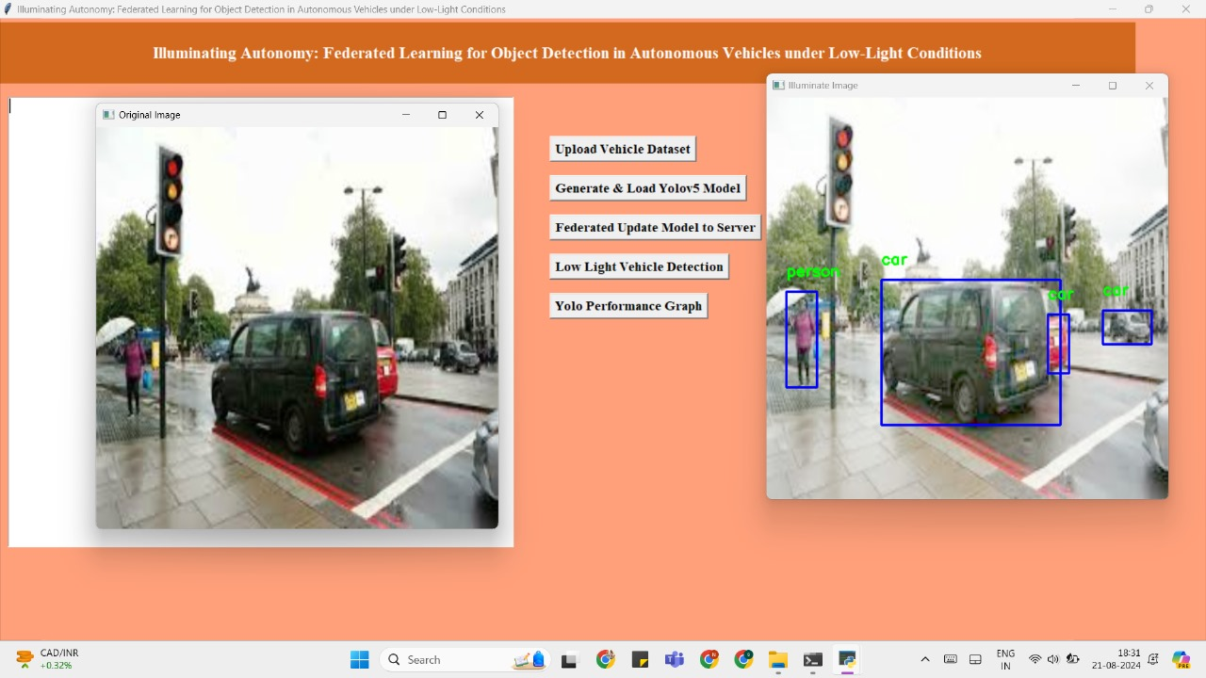

Slide 13
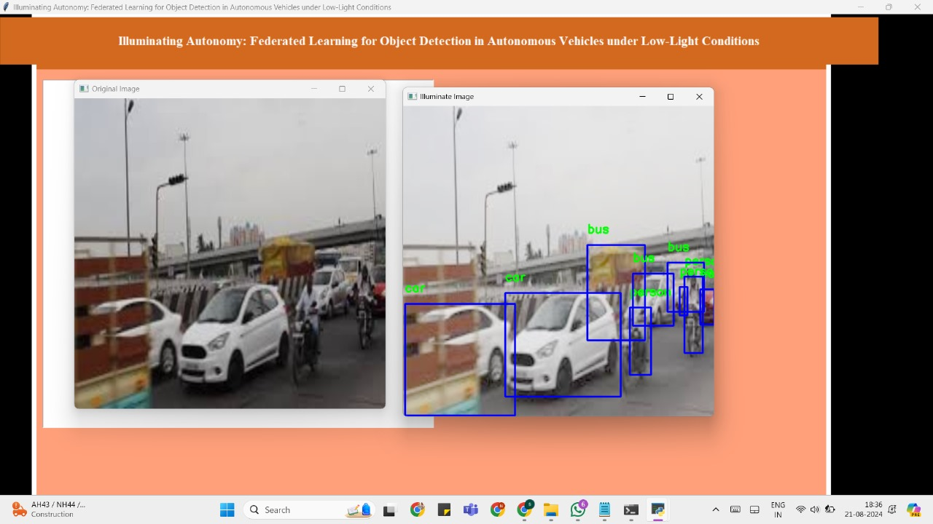

Slide 14
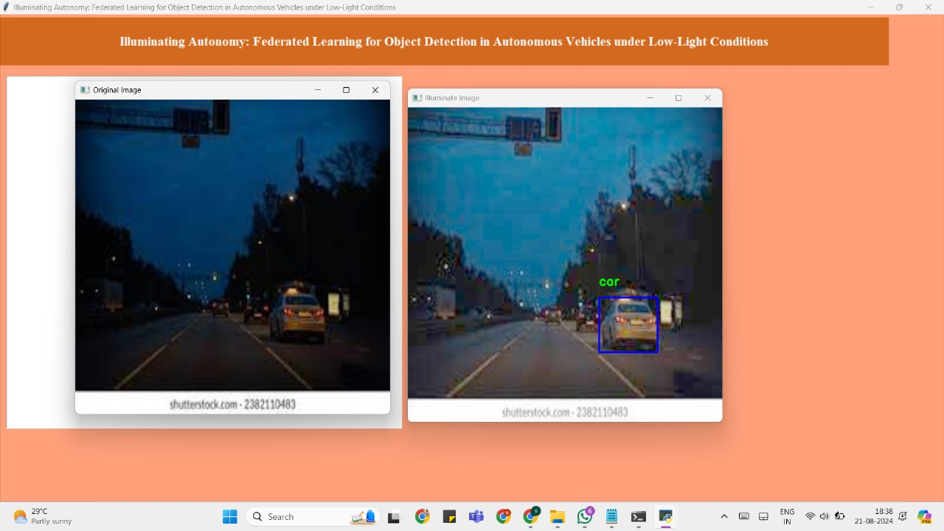

Slide 15
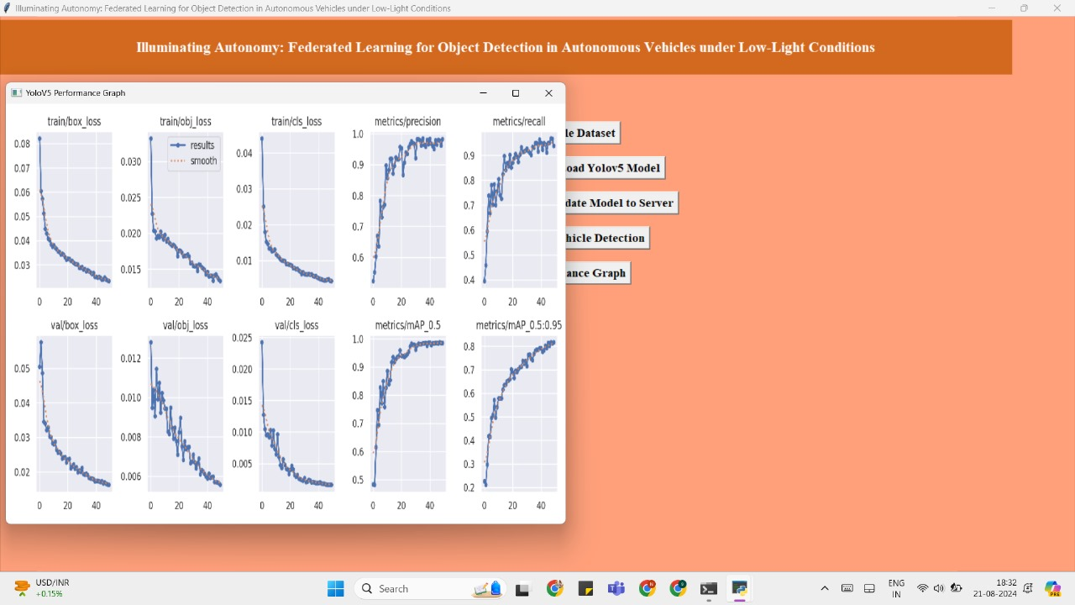

Slide 16



Challenges and Future Directions
Model Size Optimization
The current YOLOv5 model, while effective, has a large memory footprint. We aim to explore model pruning and quantization techniques to reduce model size without compromising detection accuracy, making it more suitable for resource-constrained edge devices.
Extreme Conditions Handling
The system's performance in extreme weather conditions (e.g., heavy rain, snow) remains a challenge. We plan to expand our dataset and develop specialized models for these scenarios, potentially incorporating multi-modal sensor fusion techniques.

